Slide 1
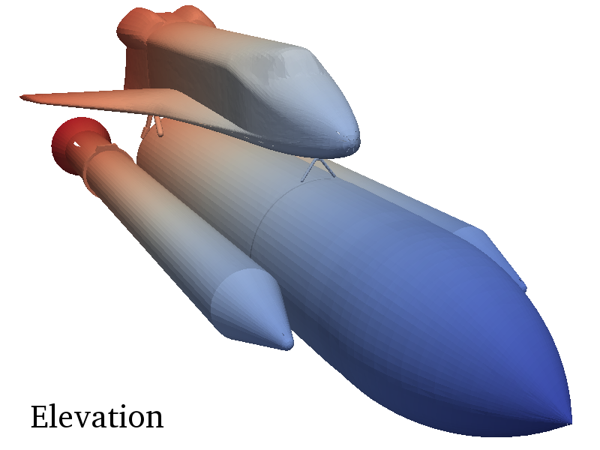
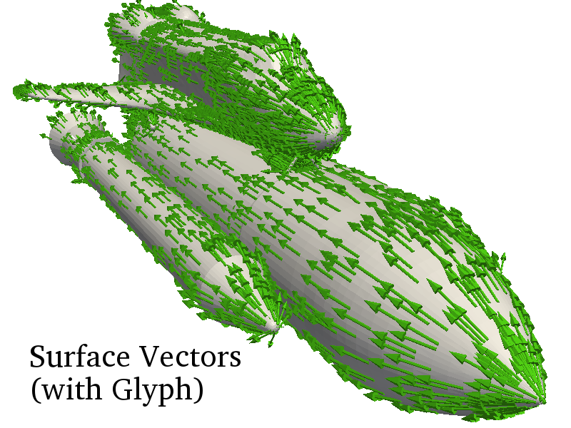
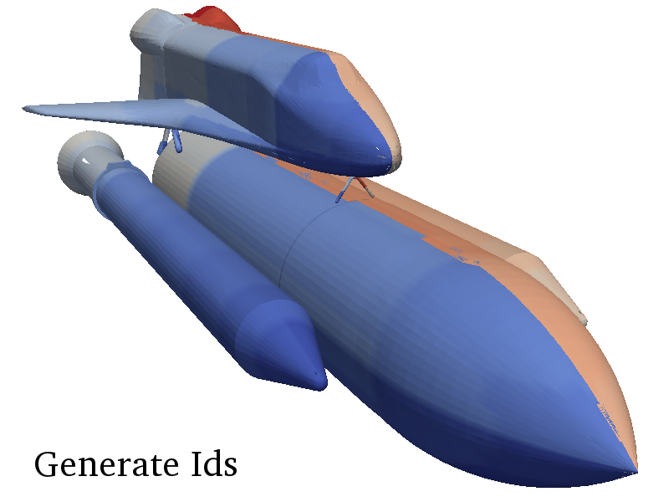
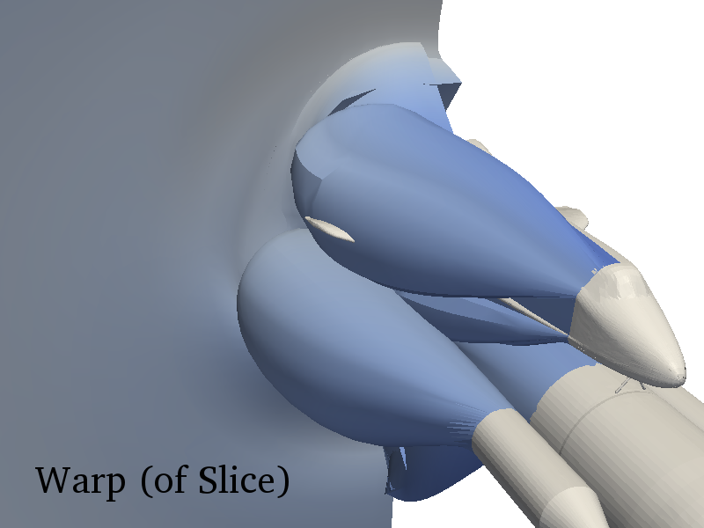
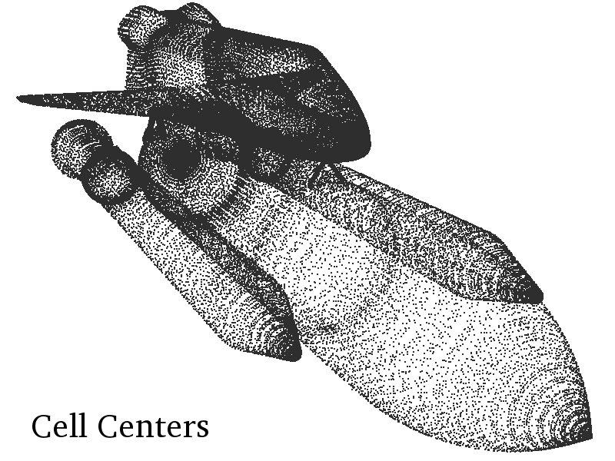
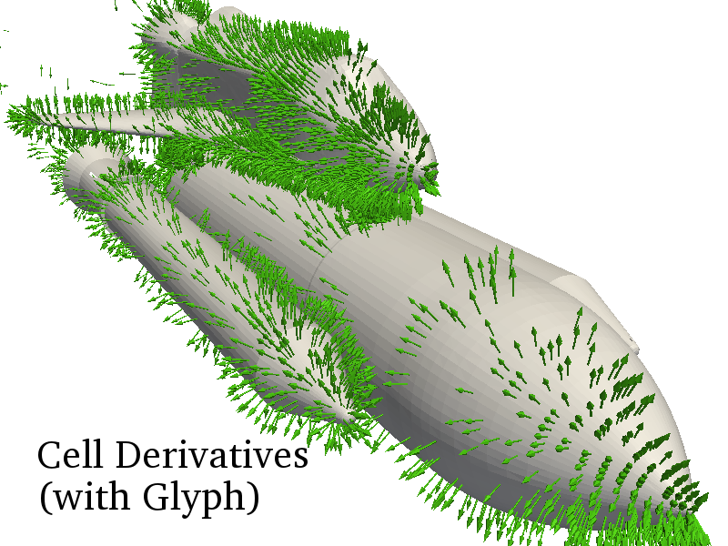
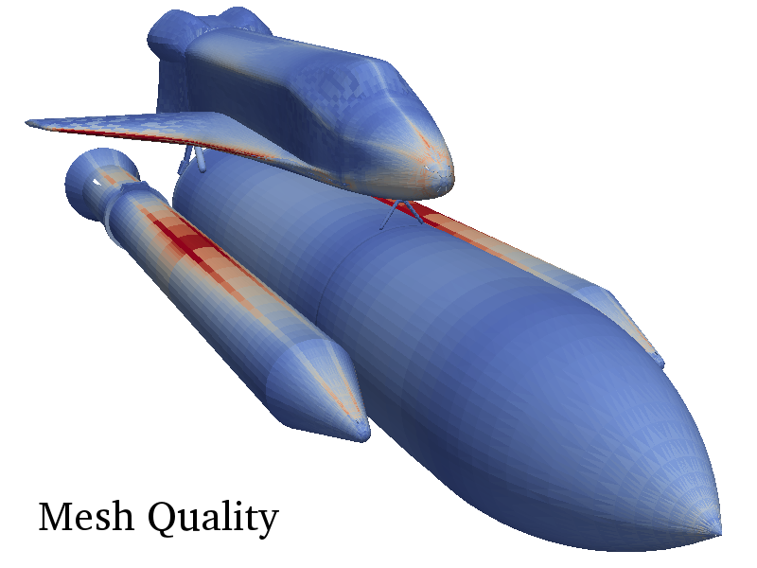
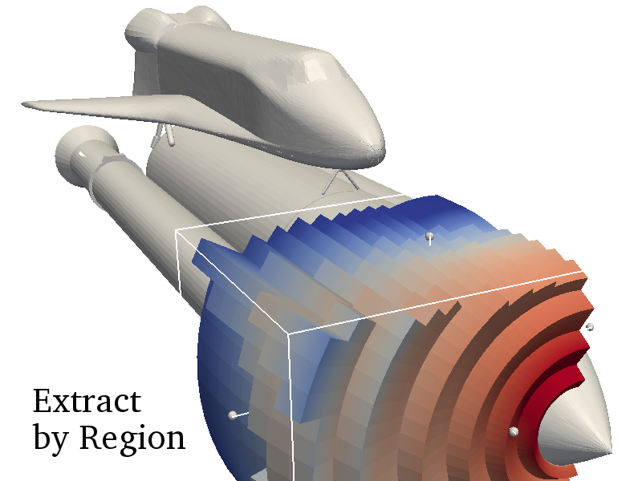
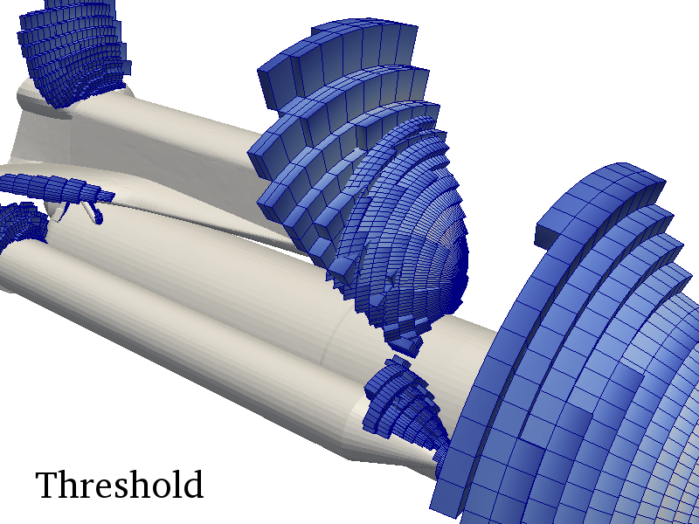
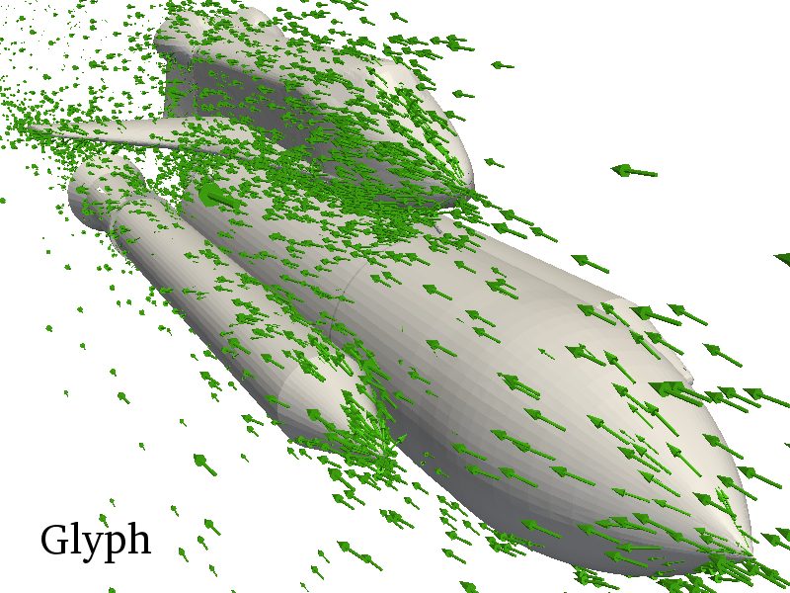
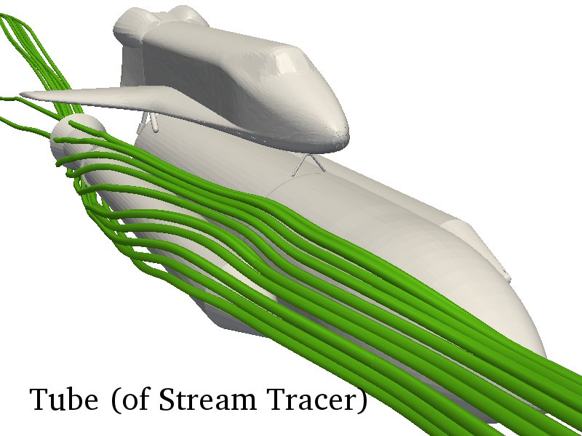
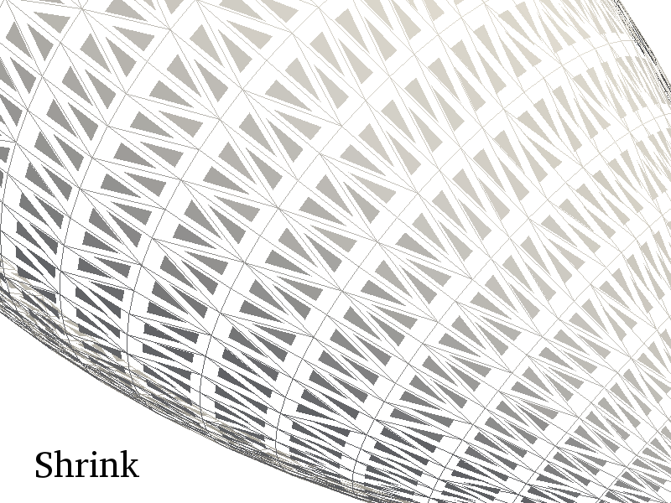
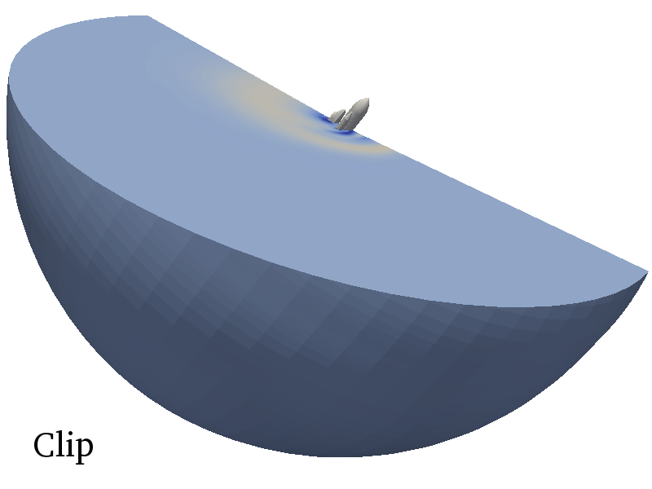
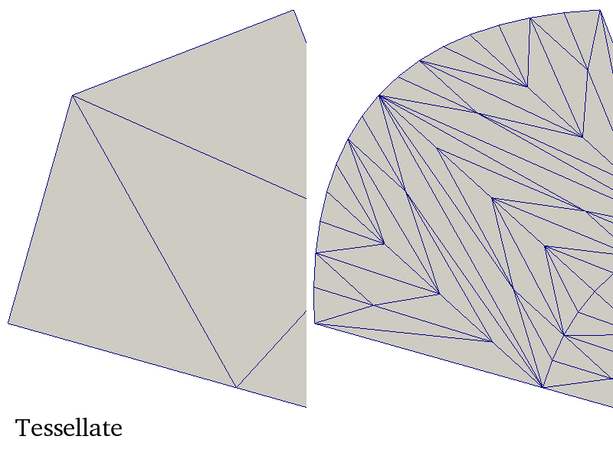
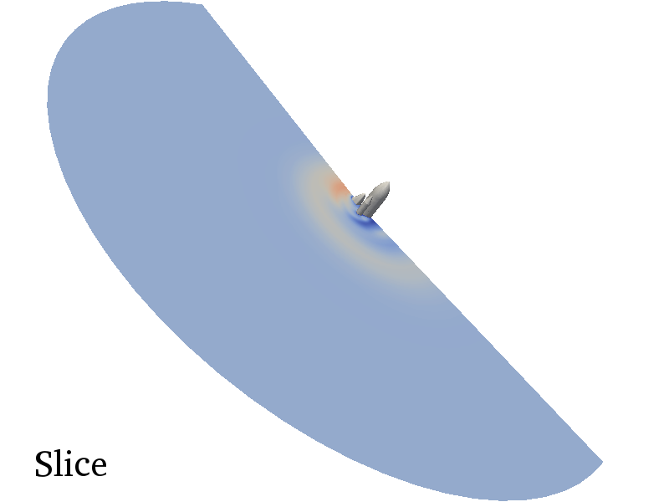
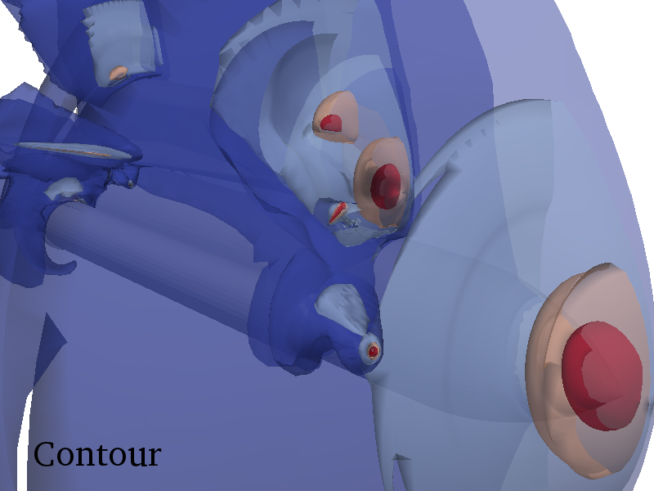
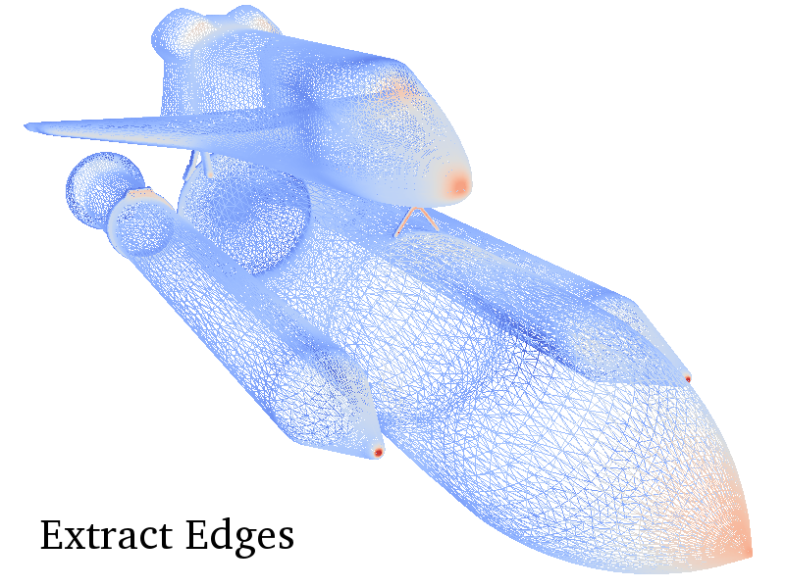
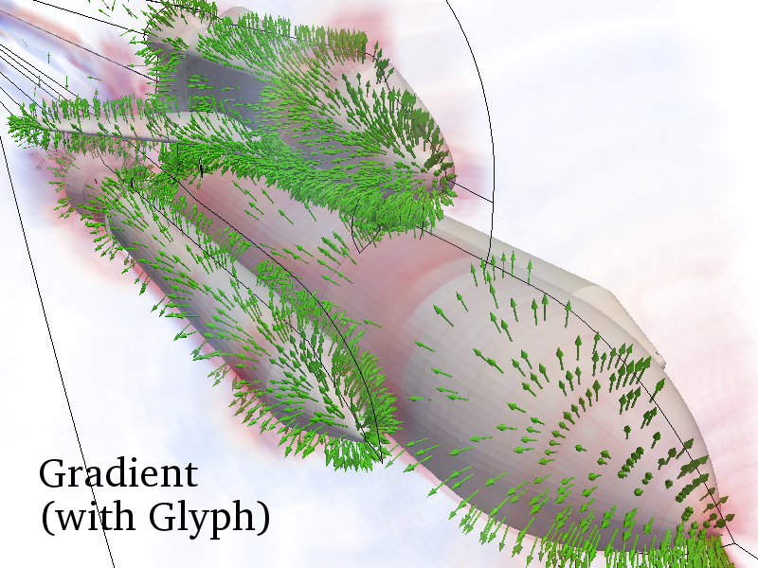
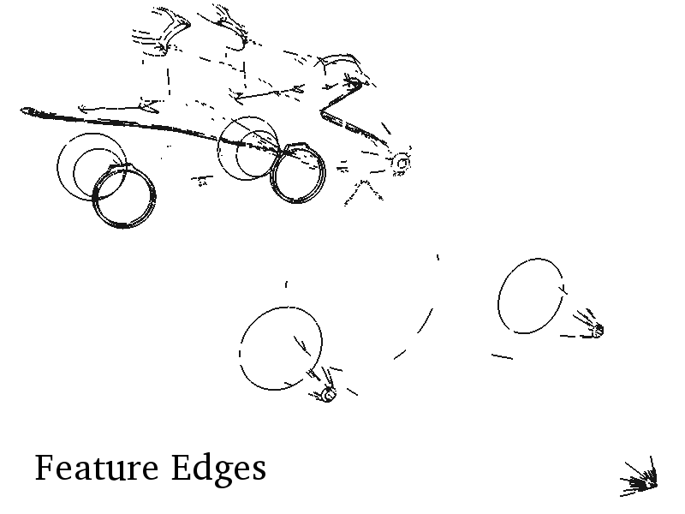
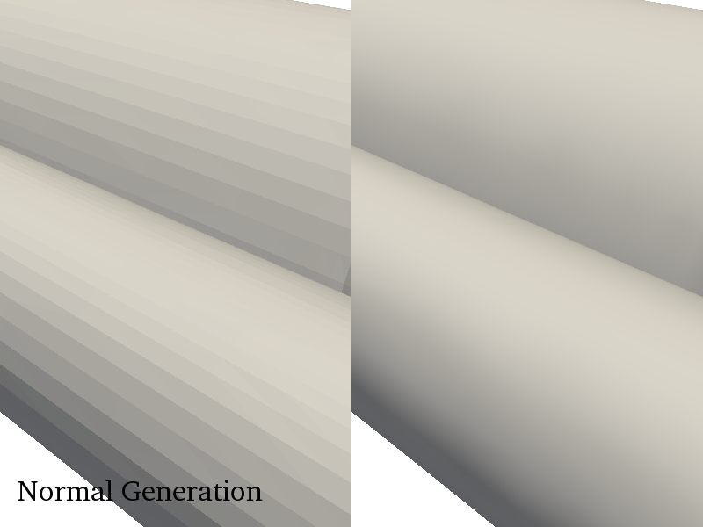
A Classification of Scientific Visualization Algorithms for Massive Threading
Kenneth Moreland Sandia National Laboratories
Berk Geveci Kitware, Inc.
Kwan-Liu Ma University of California at Davis
Robert Maynard Kitware, Inc.
November 17, 2013

Slide 2
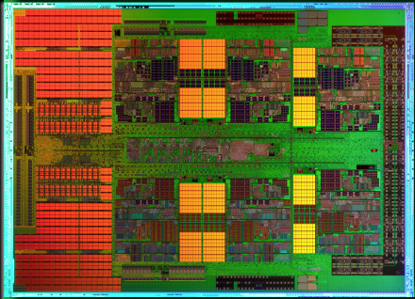
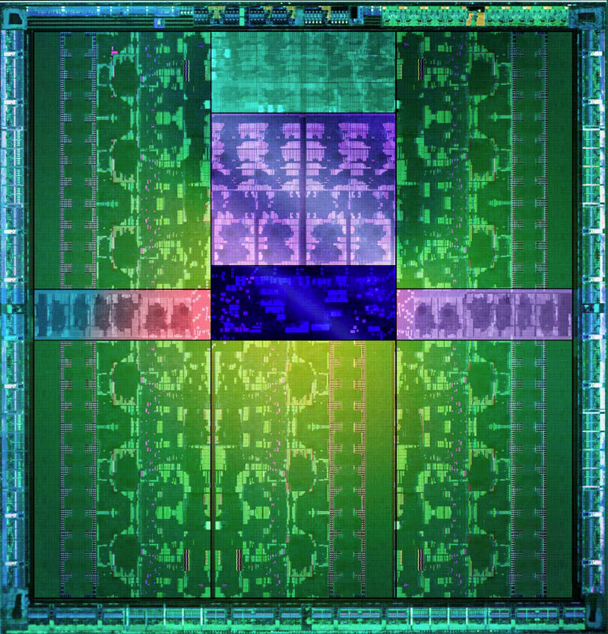
Cielo
AMD x86
1mm
Full x86 Core
+ Associated Cache
8 cores per die
MPI-Only feasible
1 x86
core
1 Kepler
core
Trinity (option 1)
NVIDIA GPU
2,880 cores collected in 15 SMX
Shared PC, Cache, Mem Fetches
Reduced control logic
MPI-Only not feasible
Notes:
What I want to emphasize is the difference between the cores on Cielo and those on accelerators of the type being considered for Trinity.
Each core on Cielo is a fully featured traditional x86 architecture and all the optimizations associated with it.
An accelerator core, in contrast, is significantly stripped down.
You cannot treat them like a symmetric multiprocessor. They are more like SIMD (but not quite as restrictive).
Unlike Cielo, running on Trinity will not simply be “scaling up”.

Slide 3
Extreme Scale is Threads, Threads, Threads!
 | Jaguar – XT5 | Titan – XK7 | Exascale*
Cores | 224,256 | 299,008 and 18,688 gpu | 1 billion
Concurrency | 224,256 way | 70 – 500 million way | 10 – 100 billion way
Memory | 300 Terabytes | 700 Terabytes | 128 Petabytes
To succeed at extreme scale, you need to consider the finest possible level of concurrency
Expect each thread to process exactly one element
Disallow communication among threads
*Source: Scientific Discovery at the Exascale, Ahern, Shoshani, Ma, et al.
Notes:
In the transition from Jaguar to Titan caused the concurrency to jump 2-3 orders of magnitude.

Slide 4
Data Parallel Visualization
Duplicate processes run independently on different partitions of data.

Slide 5
Data Parallel Visualization
Duplicate processes run independently on different partitions of data.

Slide 6
Data Parallel Visualization
Duplicate processes run independently on different partitions of data.

Slide 7
Data Parallel Visualization
Duplicate processes run independently on different partitions of data.

Slide 8
Data Parallel Visualization
Duplicate processes run independently on different partitions of data.

Slide 9
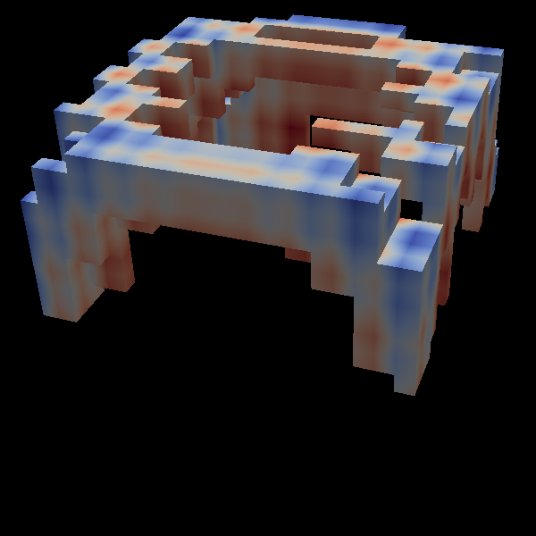
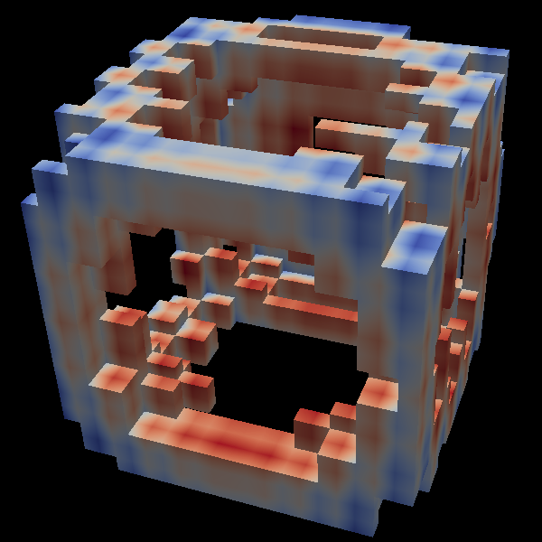
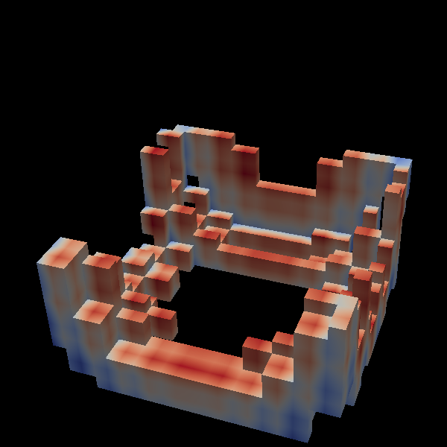
Key Principles
[Law et al., 1999]
Data Separability
Mappable Input
Result Invariant
Filter
Filter
Filter
Filter

Slide 10


Mappable Input Can Break Down
Coarse Parallelism
Result reasonably divided among partitions.
Massive Parallelism
Most partitions are empty.
Notes:
The problem with mappable input is that we have limited information to define partitions. Generally partition based on input.
For coarse parallelism, the regions are usually large enough to have a reasonable distribution in the output even if it is not perfectly load balanced.
For massive parallelism, a partition might span only a single element.
For an algorithm like Marching Cubes, that means most of the partitions are empty.
For reasonable data management, you need a way merge these partitions into something not known a priori.

Slide 11
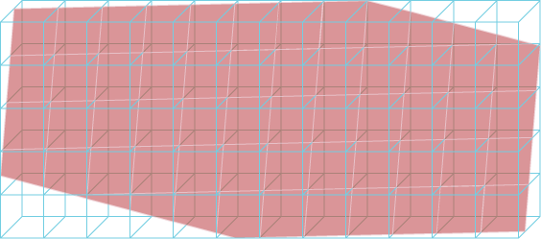
Result Invariant Can Break Down
Notes:
The Result Invariant requirement can also break down at massive threading.
Consider a simple slice operation that looks like this when run in serial.

Slide 12
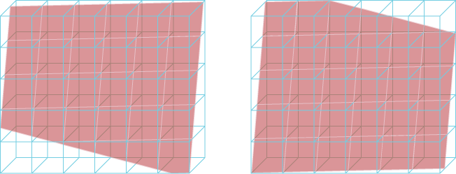
Result Invariant Can Break Down
Repeated Vertices
Notes:
When coarsely partitioned, the result looks like this.
The result is equivalent in that we get the same cells in the same positions.
If we look closer, the surface is no longer quite manifold.
This separation introduces repeated vertices at the boundary of partitions.
However, this is manageable as long as the boundaries comprise a small part of the full data.
The extra memory for representation is small.
The interface can be handled with ghost regions.

Slide 13
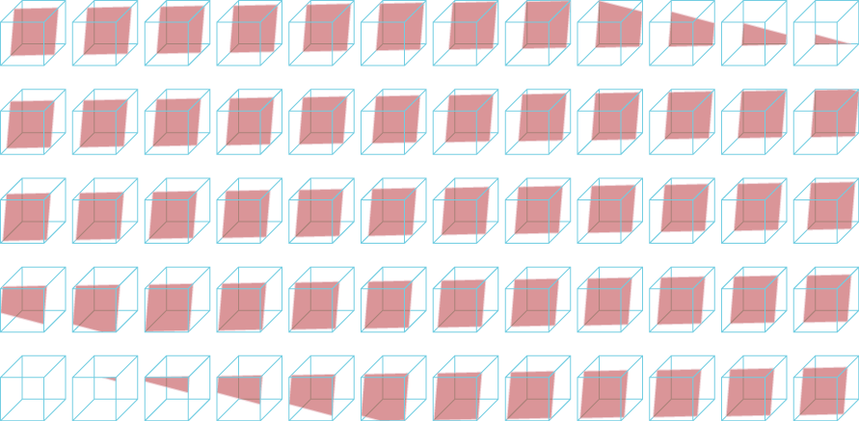
Result Invariant Can Break Down
Notes:
However, with massive threading, we have to start thinking about the possibility that every cell is its own partition.
Here we can see that the representation starts to break down.
Every single vertex in the mesh is repeated. All features of manifold geometry are lost. It is not reasonable to use ghost cells to manage boundaries.

Slide 14
New Key Principles
Coarse Parallel
Massive Parallel
Data Separability
Mappable Input
Result Invariant
Data Separability
Discoverable Input Mapping
Collective Work
Notes:
For massively threaded parallel we need to modify our key principles
Data Separability remains the same, but we recognize that there are multiple different ways to break up the data.
It matters whether you are dividing among points, cells, faces, edges, or some other element. It matters what incidence relationships you need to capture.
We change our mapping to state that we can determine the existence of output elements from the input efficiently without computing the actual output.
We recognize that many algorithms cannot reasonably be performed by completely independent threads.
The tricks we used with ghost regions won’t work anymore.
Thus, we are going to identify the part of the algorithm that is interdependent and try to encapsulate it in a collective operation.

Slide 15
Characterization and Classification
Key Principles
Characterization Parameters
Data Separability
Discoverable Input Mapping
Collective Work
Separable Element
Point Mapping
Cell Mapping
Field Mapping
Collective Work

Slide 16
Basic Mapping
Input
Output

Slide 17
Basic Mapping
f( )
x
f(x)
Input
Output

Slide 18
Basic Mapping
Separable Element | Any
Point Mapping | Identity
Cell Mapping | Identity
Field Mapping | 1 to 1
Collective Work | None

Slide 19
Basic Mapping
functor()
Notes:
Our basic approach to portable and efficient multicore algorithms is essentially that presented by Baker and colleagues.
Break the algorithm into sections that can be run on single (or small) sections of data and encapsulate that in a C++ functor object.
Using generic programming, provide a mapping function to schedule the functor on many threads to concurrently process a vector.
Dual benefits:
Simplifies algorithm design by placing the bulk of the work in a serial functor.
One porting of the map function to multiple parallel systems can be applied to any number of functor algorithms. Also works well in lightweight thread environment.

Slide 20
Map by Cell
Input
Output

Slide 21
Map by Cell
f( , , , )
x₄
x₃
f(x₁, x₂, x₃, x₄)
x₁
x₂
Input
Output

Slide 22
Map by Cell
Separable Element | Cell
Point Mapping | Identity
Cell Mapping | Identity
Field Mapping | Points on cell to cell
Collective Work | None

Slide 23
Map by Cell
functor()
Notes:
However, we find this basic model a bit too simplistic.
We are most interested in mapping operations to connected topologies, which means that the inputs and outputs of the operations are dependent on these connections.
For example, the computation of an operation may depend on a collection of data around a small neighborhood.

Slide 24
Reconnect Cell
Input
Output

Slide 25
Reconnect Cell
Input
Output

Slide 26
Reconnect Cell
Input
Output

Slide 27
Reconnect Cell
Separable Element | Cell
Point Mapping | 1 to 0 or 1
Cell Mapping | 1 to 0 or more
Field Mapping | Identity
Collective Work | None (or find unused)
Notes:
Also triangulate

Slide 28
Reconnect Cell
Keep these
Remove these
Output

Slide 29
Build Independent Topology
Input
Output

Slide 30
Build Independent Topology
Input
Output

Slide 31
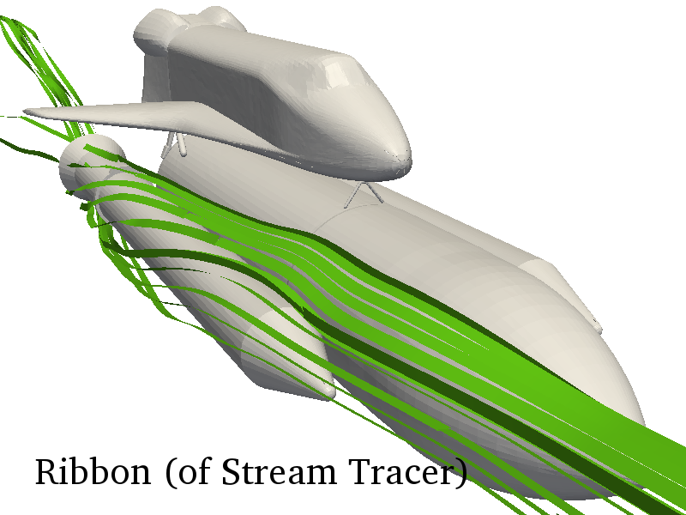
Build Independent Topology
Separable Element | Any
Point Mapping | 1 element to many points
Cell Mapping | 1 element to many cells (constant number)
Field Mapping | Identity
Collective Work | None
Notes:
Also triangulate

Slide 32
Build Connected Topology
Input
Output

Slide 33
Build Connected Topology
Input
Output

Slide 34
Build Connected Topology
Input
Output

Slide 35
Build Independent Topology
Separable Element | Cell
Point Mapping | 1 cell to 0 or more points
Cell Mapping | 1 to 0 or more
Field Mapping | Interpolated points
Collective Work | Resolve duplicate points

Slide 36
Build Connected Topology
Merge points
Output

Slide 37
Capture Cell Adjacencies
Input
Output

Slide 38
Capture Cell Adjacencies
f( , , , )
x₄
x₃
f(x₁, x₂, x₃, x₄)
x₁
x₂
Input
Output

Slide 39
Capture Cell Adjacencies
Separable Element | Point, edge, or face
Point Mapping | Identity
Cell Mapping | Identity
Field Mapping | Interpolated incident fields
Collective Work | Find incidence relationships

Slide 40
Capture Cell Adjacencies
x₄
x₃
Incidence relationships may not be explicitly captured by topology structure.
x₁
x₂
Input

Slide 41
Globally Reduce
f/(x₁,x₂,x₃,…)
Input

Slide 42
Globally Reduce
f/(x₁,x₂,x₃,…)
Input

Slide 43
Globally Reduce
f/(x₁,x₂,x₃,…)
Input

Slide 44
Globally Reduce
Separable Element | Any
Point Mapping | None in output
Cell Mapping | None in output
Field Mapping | All to 1
Collective Work | Global Reduction
Algorithms | Histogram Integrate Outline (find bounds) Statistics

Slide 45
Query Data
x
f(x)
Search Structure
Output

Slide 46
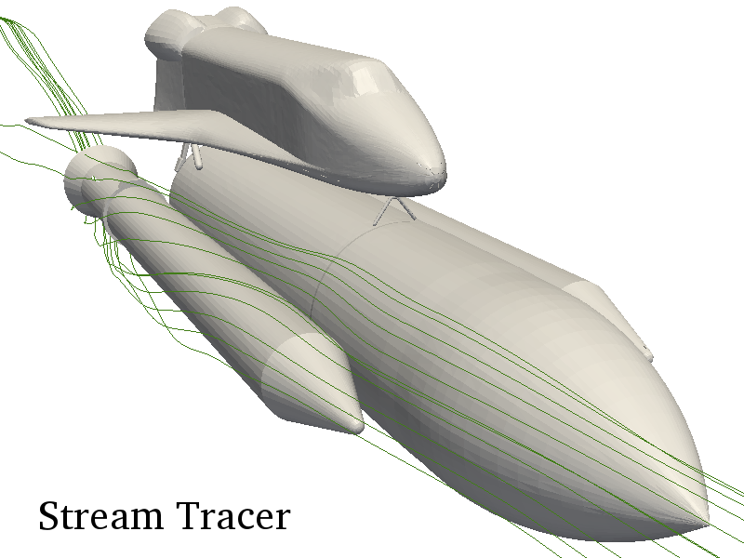
Query Data
Separable Element | Point, key, or query
Point Mapping | Identity
Cell Mapping | Identity
Field Mapping | 1 query to 1 output
Collective Work | Building query structure

Slide 47
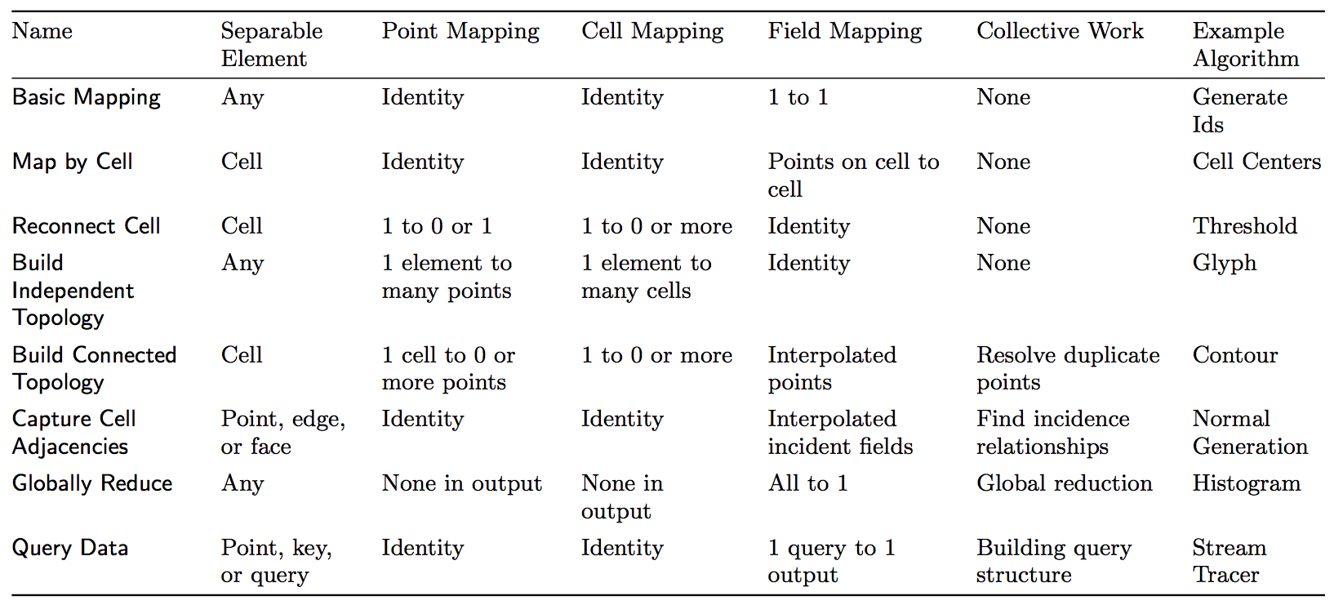
Summary

Slide 48
Conclusion
Accelerators and other emerging architectures use massive threading that takes parallelism to a whole different scale
Visualization algorithms can be characterized by:
How data is separated
How input elements are mapped to output elements
What collective work is performed
Algorithms that share all three characterizations can be implemented with similar mechanisms
We can exploit this observation to implement new algorithms

